Slide 1
Part 2 – Linear Models

Slide 2
Overview
Linear regression in R
Using lm in other contexts
Extending the lm framework

Slide 3
Prep
Open script linear_models.R

Slide 4
Data
Using the knowledge you’ve gained this morning - install and load the package NHANES
The NHANES dataset is the National Health and Nutrition Examination Survey
Next, explore the dataset (how many variables are there, what are they called, how are they measured etc.)
Use the search function to find the descriptions about the variables within the dataset

Slide 5
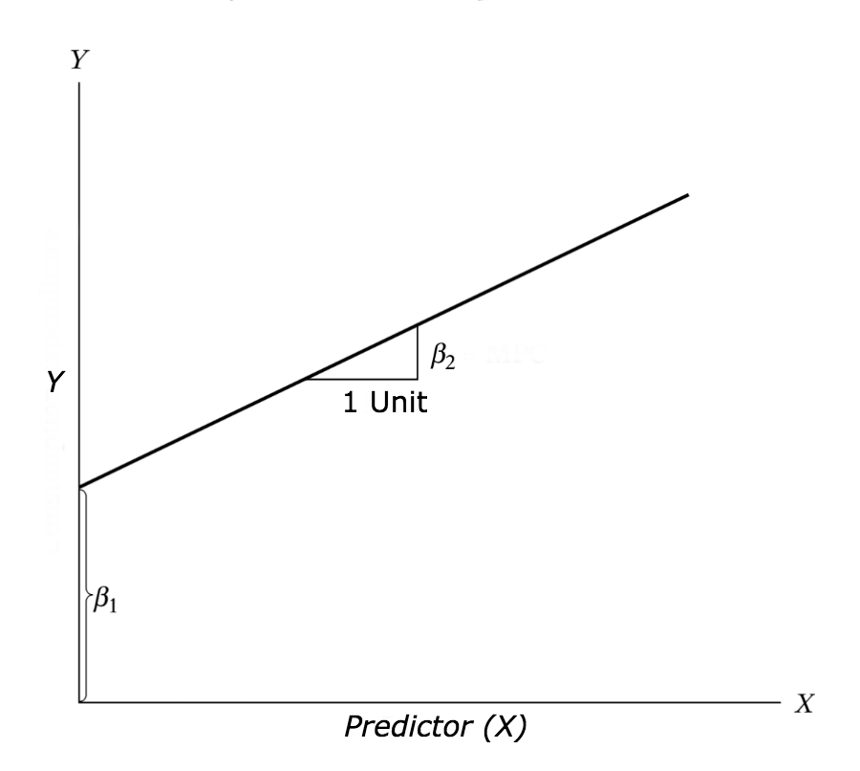
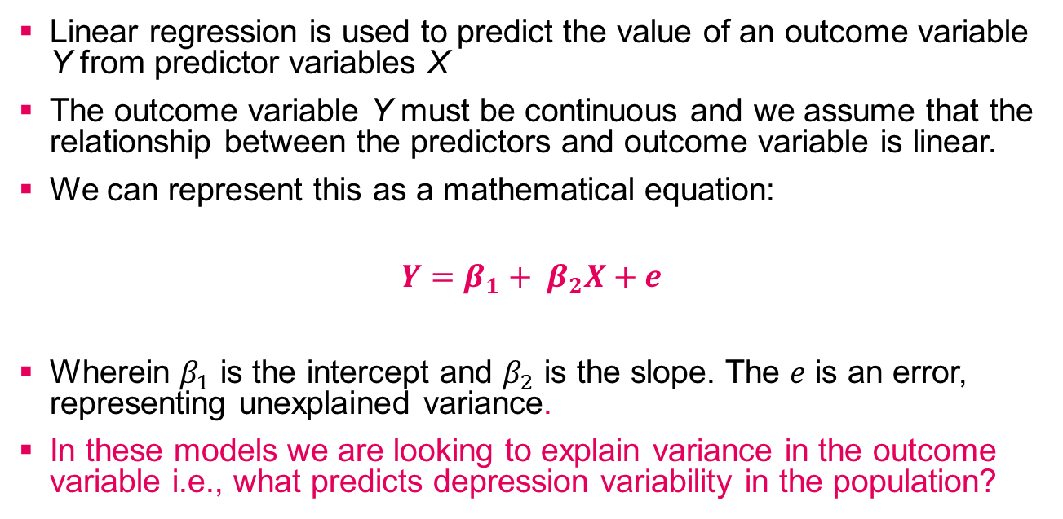
Linear Regression – Quick Recap
Linear regression is used to predict the value of an outcome variable Y from predictor variables X
The outcome variable Y must be continuous and we assume that the relationship between the predictors and outcome variable is linear.
We can represent this as a mathematical equation:
$$Y=β_{1}+ β_{2}X+e$$
Wherein $β_{1}$ is the intercept and $β_{2}$ is the slope. The $e$ is an error, representing unexplained variance.
In these models we are looking to explain variance in the outcome variable i.e., what predicts depression variability in the population?

Slide 6
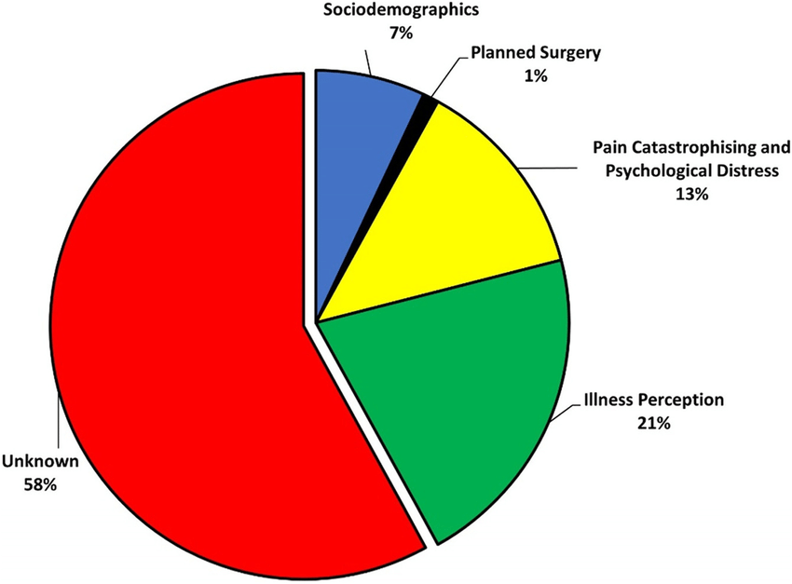
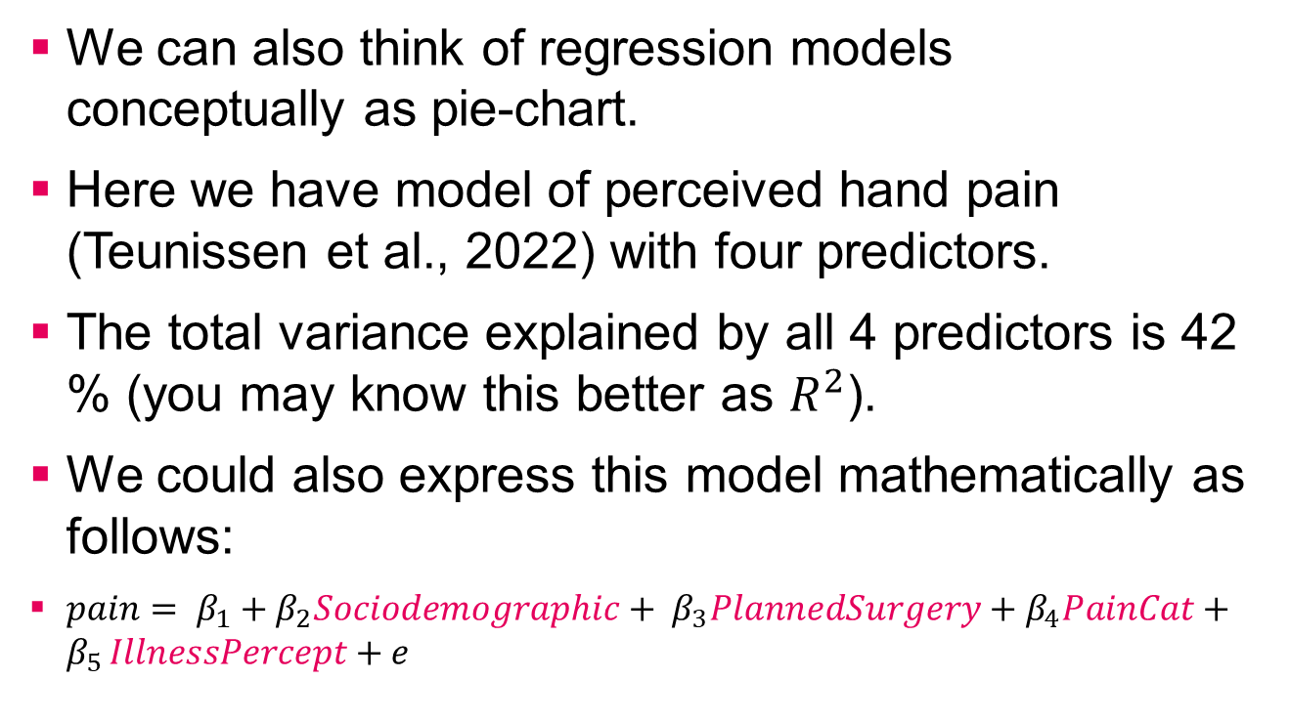
We can also think of regression models conceptually as pie-chart.
Here we have model of perceived hand pain (Teunissen et al., 2022) with four predictors.
The total variance explained by all 4 predictors is 42 % (you may know this better as $R^{2}$).
We could also express this model mathematically as follows:
$pain= β_{1}+β_{2}Sociodemographic+ β_{3}PlannedSurgery+β_{4}PainCat+β_{5 }IllnessPercept+e$

Slide 7
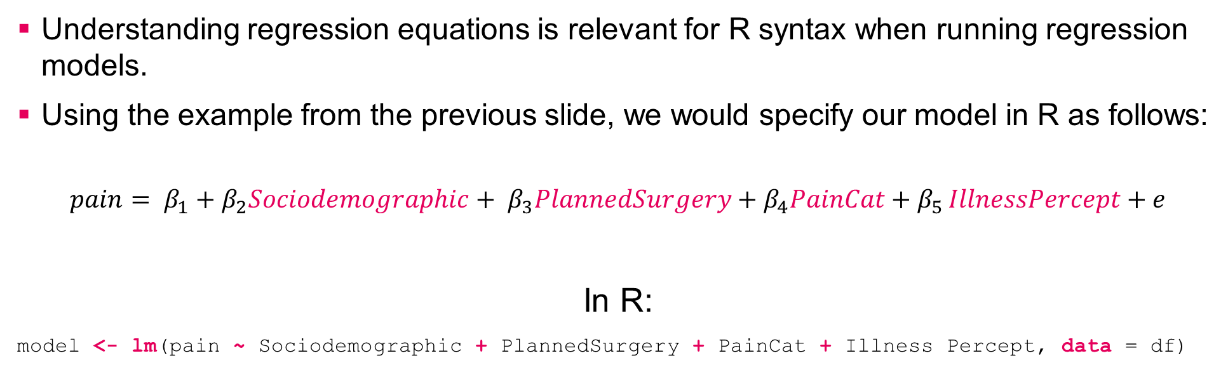
Linear Regression in R
Understanding regression equations is relevant for R syntax when running regression models.
Using the example from the previous slide, we would specify our model in R as follows:
$$pain= β_{1}+β_{2}Sociodemographic+ β_{3}PlannedSurgery+β_{4}PainCat+β_{5 }IllnessPercept+e$$
In R:
model <- lm(pain ~ Sociodemographic + PlannedSurgery + PainCat + Illness Percept, data = df)

Slide 8
Linear Regression in R
R function for linear models
model <- lm(pain ~ Sociodemographic + PlannedSurgery + PainCat + Illness Percept, data = df)
Predictor variables
Specify data to use
Outcome
Variable
Assign model
output
to name

Slide 9
Practice Task in R
We will be using NHANES data to run a series of linear regression models.
Go to back to the script linear_models.R

Slide 10
Additional Output Information
If you wish to request standardized betas, then you can use the beta.lm() function from the beta.lm package.
Example:
beta.lm(model)
For 95% confidence intervals of the unstandardized beta, use the confint() function
Example:
confint(model)

Slide 11
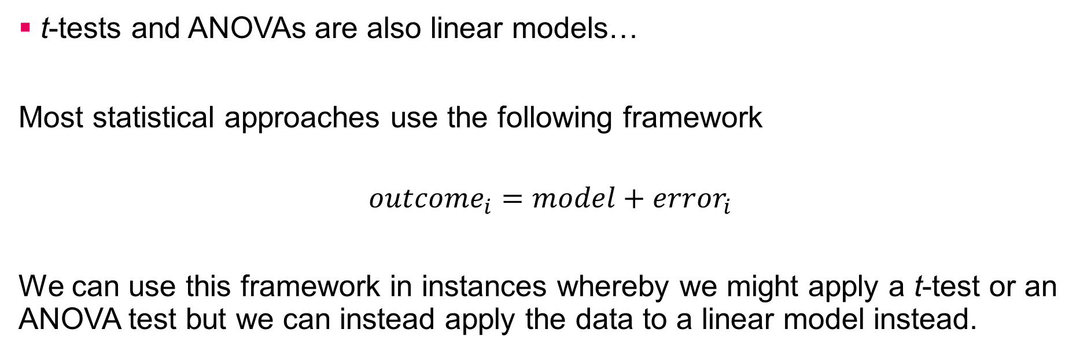
Using lm instead for t-test and ANOVA
t-tests and ANOVAs are also linear models…
Most statistical approaches use the following framework
$${outcome}_{i}=model+{error}_{i}$$
We can use this framework in instances whereby we might apply a t-test or an ANOVA test but we can instead apply the data to a linear model instead.

Slide 12
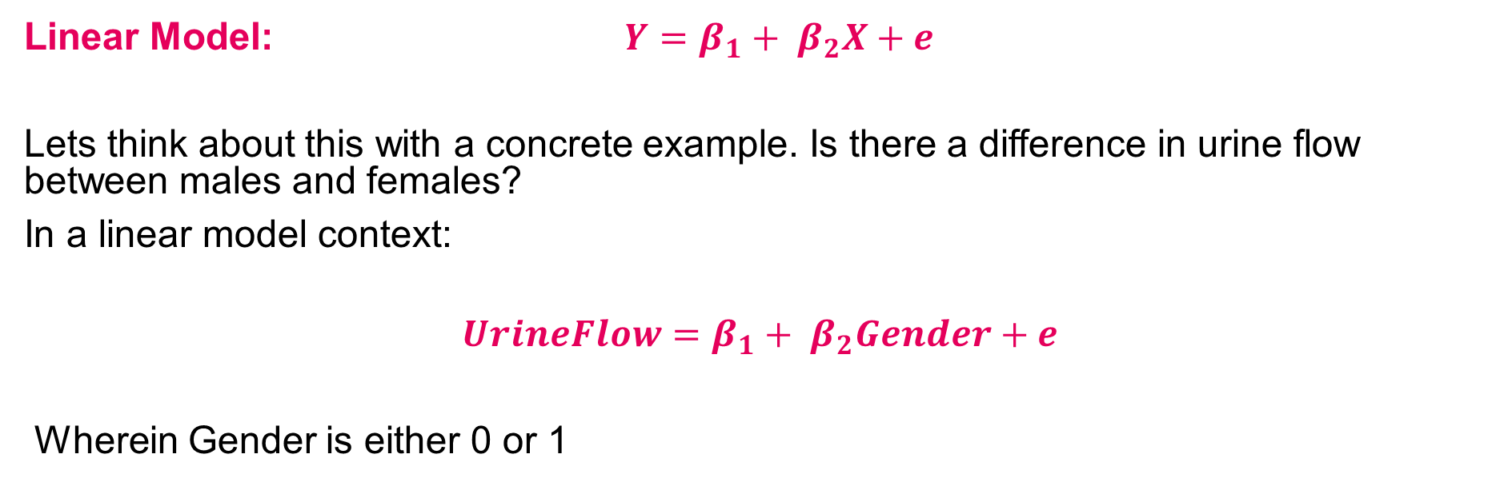
Using lm instead of t-test
Linear Model: $Y=β_{1}+ β_{2}X+e$
Lets think about this with a concrete example. Is there a difference in urine flow between males and females?
In a linear model context:
$$UrineFlow=β_{1}+ β_{2}Gender+e$$
Wherein Gender is either 0 or 1

Slide 13
Demo in R

Slide 14
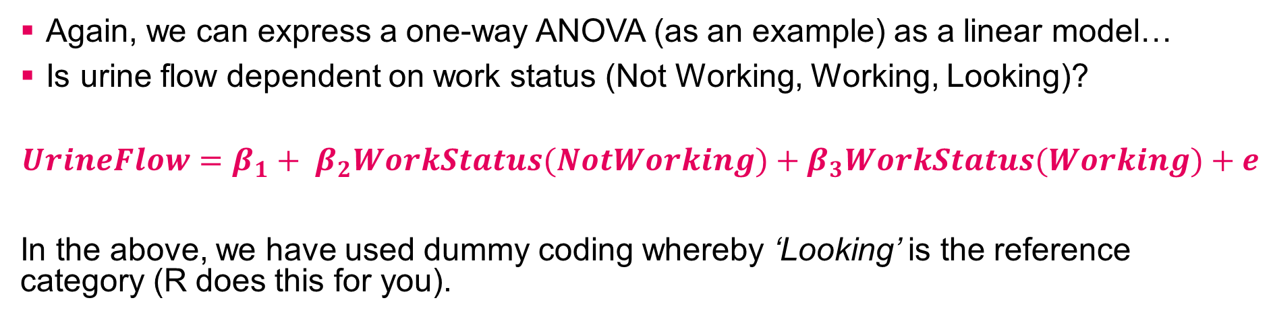
Using lm instead of an ANOVA
Again, we can express a one-way ANOVA (as an example) as a linear model…
Is urine flow dependent on work status (Not Working, Working, Looking)?
$$UrineFlow=β_{1}+ β_{2}WorkStatus(NotWorking)+β_{3}WorkStatus(Working)+e$$
In the above, we have used dummy coding whereby ‘Looking’ is the reference category (R does this for you).
= Looking
ID | UrineFlow | NotWorking | Working
1 | 1.09 | 0 | 0
2 | 0.87 | 1 | 0
3 | 0.99 | 0 | 1
= Not working
= Working

Slide 15
Demo in R

Slide 16
Take Home Message
Many of the statistical tests we learnt in our UG courses are linear models and can be expressed using lm function in R e.g., t-tests and ANOVA
Understanding the lm framework allows you to easily transition to more complex models
The nature of the outcome variable largely dictates the analytical method of choice, not the predictors.
Outcome variables have different types of distributions, we refer to these as distribution families. It is these distribution families (e.g., continuous, binomial, multinomial, ordinal, and count data) that inform which linear model to use.

Slide 17
Extending the lm framework
Using our knowledge of the code for lm we can extend this to also model non-linear outcomes
For example:
Outcome | Model Type | Function | Package | Code Example
Binary | Binary logistic | glm | stats | glm(y ~ x1 + x2, family = binomial, data = df)
Count | Poisson | glm | stats | glm(y ~ x1 + x2, family = poisson, data = df)
Ordinal | Ordinal logistic | clm | ordinal | clm(y ~ x1 + x2, link = logit, data = df)

Slide 18
Part 3 – Mixed Effects Models
A brief insight and demo

Slide 19
What are mixed effects models?
Mixed effects models are also referred to as multilevel models – and allow us to model the nested nature of data.
Specifically, much of the data that we collect in psychology involves collecting data from participants responding to multiple stimuli or nested in grouping structures (e.g., students within schools).
This violates one important assumption of linear models, that the observations are independent.

Slide 20
Example – Experiment
Avg Reaction Time
Reaction Time
P1
P2
P3
Stimulus
1
2
3
4
5
6
7
8
9
10
P4
P5
P6
P1
P1
P1
P7
P1
P1
P1
P1
P1
P1
P1
P2
P2
P2
P8
P2
P2
P2
P2
P2
P2
P2
P3
P3
P3
P9
P3
P3
P3
P3
P3
P3
P3
P4
P4
P4
P10
P4
P4
P4
P4
P4
P4
P4
P5
P5
P5
P5
P5
P5
P5
P5
P5
P5
P6
P6
P6
P6
P6
P6
P6
P6
P6
P6
P7
P7
P7
P7
P7
P7
P7
P7
P7
P7
P8
P8
P8
P8
P8
P8
P8
P8
P8
P8
P9
P9
P9
P9
P9
P9
P9
P9
P9
P9
P10
P10
P10
P10
P10
P10
P10
P10
P10
P10

Slide 21



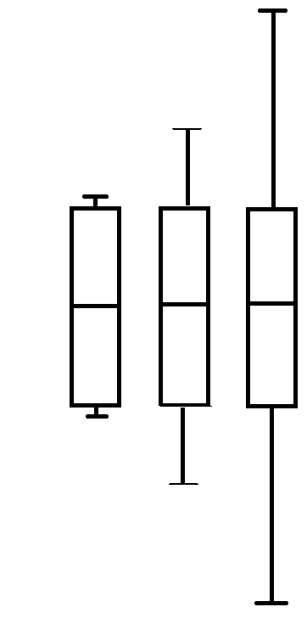
Example - Experiment
Stimulus 1
Stimulus 2
Stimulus 3
Median RT

Slide 22
Example – Classrooms
Classroom 1
Classroom 2
Classroom 3
Child
Child
Child
Child
Child
Child
Child
Child
Child

Slide 23
Fixed and Random Effects
Fixed effects are variables that are constant across individuals, for example age and sex.
Up until now all the statistical analyses you have been doing have assumed the independent variables are fixed effects
Whereas a random effect is used to model instances whereby categorical variables (e.g., stimuli type, group membership) are a random sample from a larger population. In a random effects model, the effect of the categorical variables is allowed to vary across the levels of the variable.
In random effects models we can model the possibility that the effect of variable may be different in different groups or levels of the variable.

Slide 24
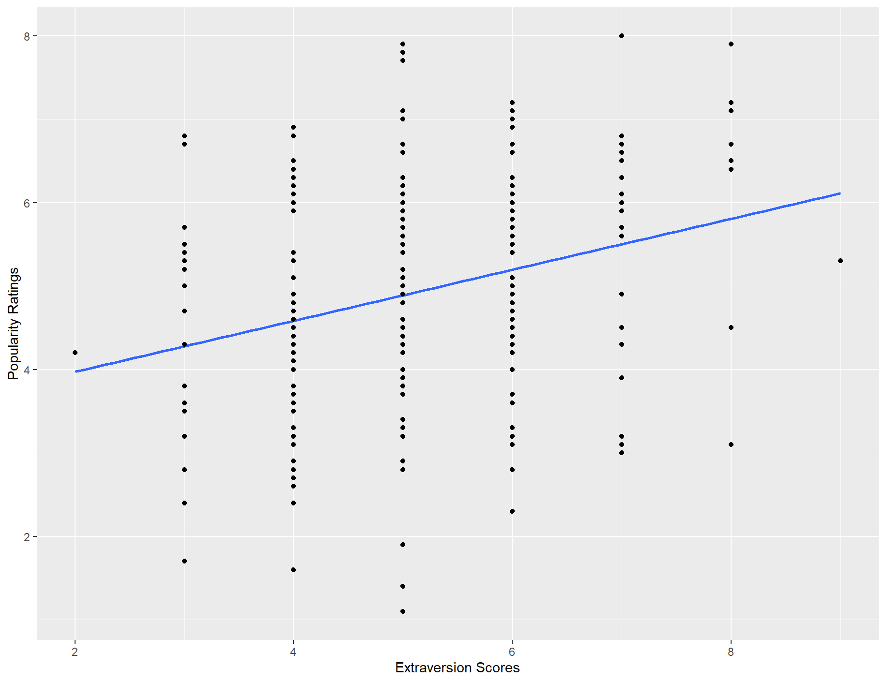
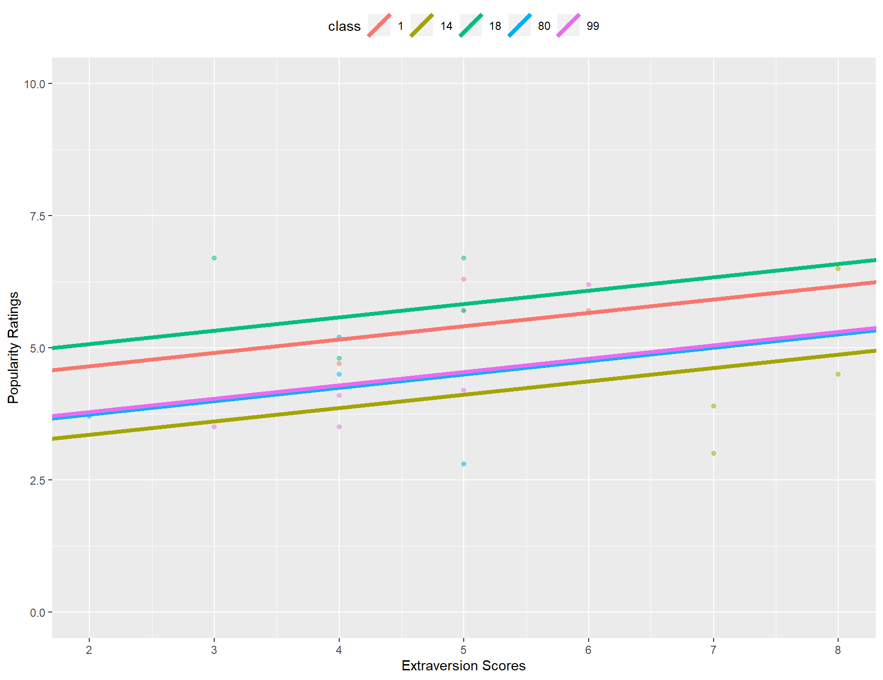
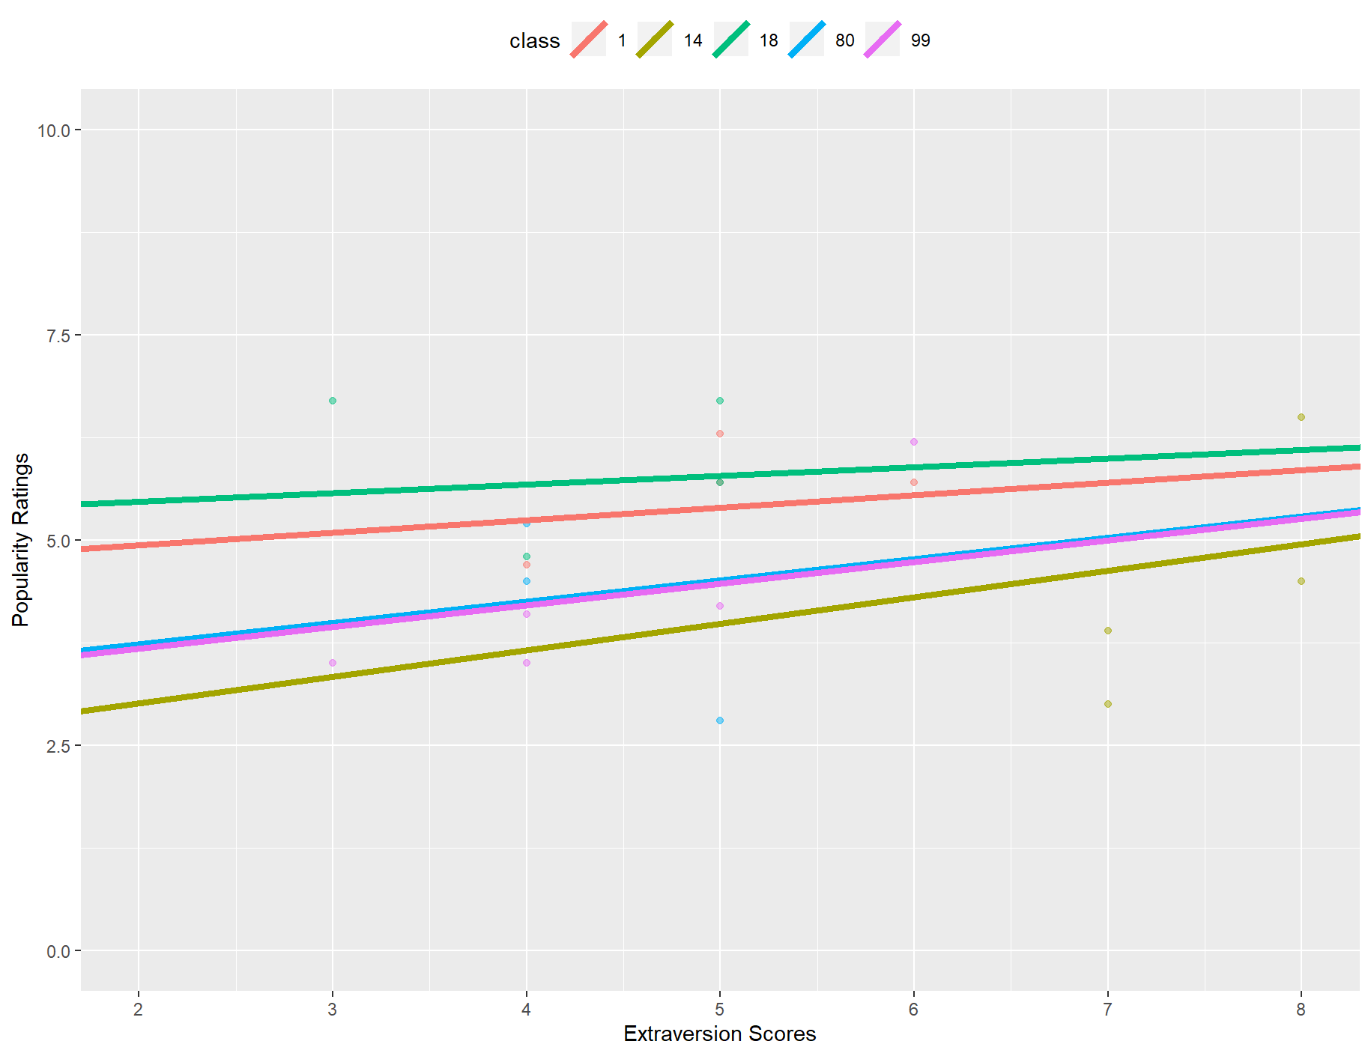
Random Intercepts and Random Slopes
We can specify random effects to either have just random intercepts or to also have random slopes.
No random effects
Random intercept
Random intercept
& random slope

Slide 25
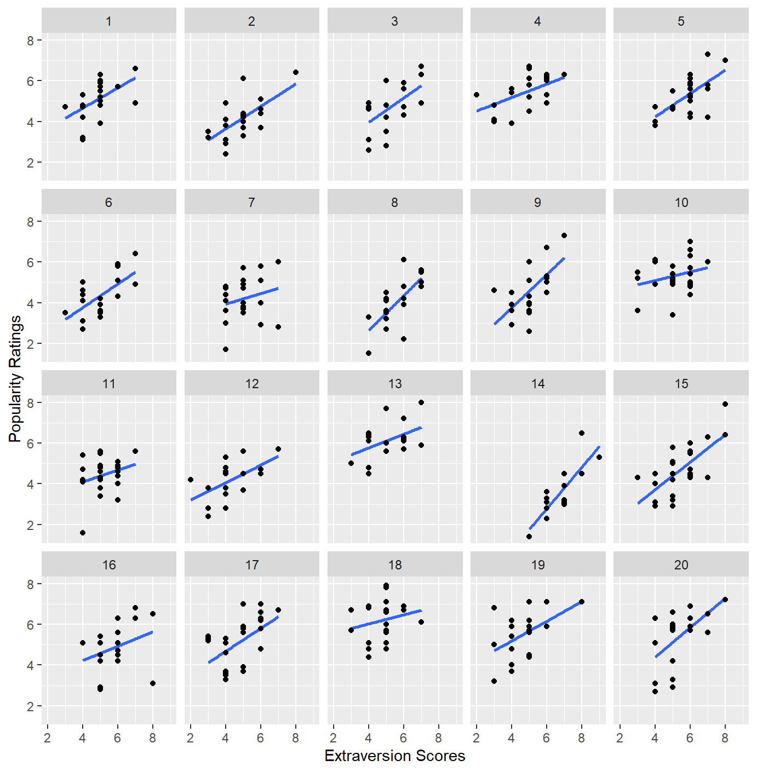
Demo – School Data
Data are collected from 100 classrooms exploring the relationship between and popularity ratings and self-reported extraversion scores.
Here we have children nested in classrooms – and therefore classroom is our grouping factor.
Note: This data is adapted from a more complex tutorial by Rens van de Schoot, see: https://www.rensvandeschoot.com/tutorials/lme4/

Slide 26
Demo in R

Slide 27
Fixed and Random Effects – Extra notes
Some example of groupings which should be included as random intercepts:
Participants
Classes and Schools
Therapists or treatment providers (e.g. in cluster randomised trial)
Stimuli or ‘items’
Random slopes:
Where the effect of a variable might vary between individuals (or other grouping) should be considered for inclusion as a random slopes. Some examples might include:
Time (or some function of time)
An experimental intervention (e.g. in a factorial design)

